Slide 1
Concurrent Code
A circuit is said to be combinational when its output depends uniquely on its preset input, so the circuit has no clock or memory.
Purely concurrent VHDL code (i.e., without processes) is proper for implementing only combinational circuits.
The statements when, select, and generate are commonly used.
Many combinational circuits can be constructed without any formal statement thanks to the large collection of predefined operators (which are just function calls)

Slide 2
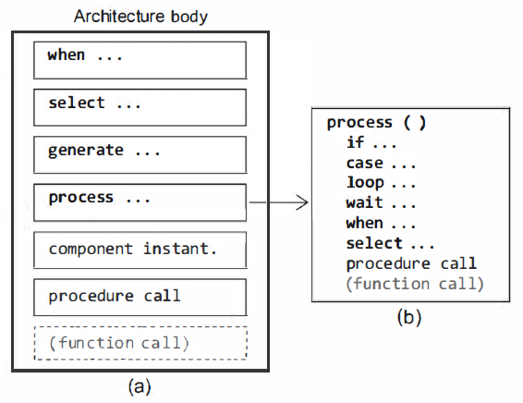
Concurrent Statements
The architecture body can be constructed with only concurrent statements (recall that VHDL is inherently concurrent rather than sequential),

Slide 3
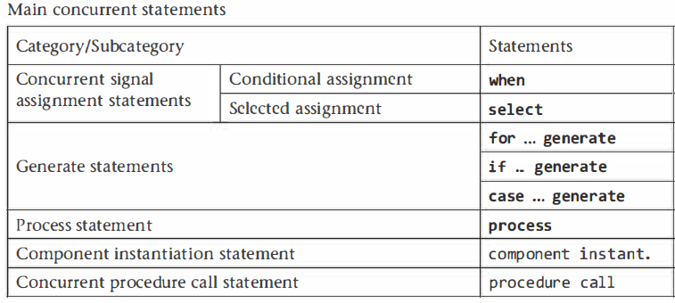
Concurrent Statements
A special statement in the list is the process statement.
Although as a whole it is concurrent with respect to all other statements, internally it is sequential, so only sequential statements can be used inside a process)
The formal designations for the concurrent statements of figure 1O.1a, according with the IEEE 1076 standard, are shown

Slide 4
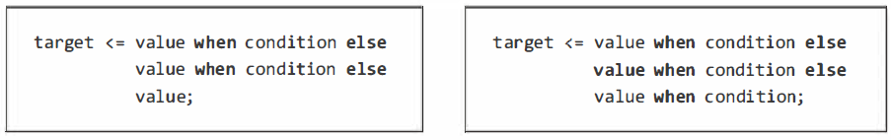
The when Statement
An assignment using the when statement is called a conditional assignment.
The target in the syntax above is a signal (VHDL-2008 allows when to be used also in sequential code, so there the target can be also a variable).
The value can range from a simple static value up to several values.
Any number of tests is allowed.
The when statement has a priority-encoding nature (for any given line to be executed, the tests in all preceding lines must return false)

Slide 5
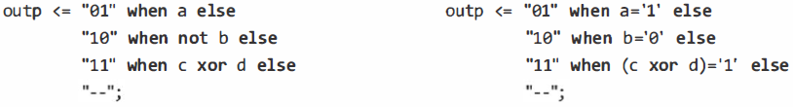
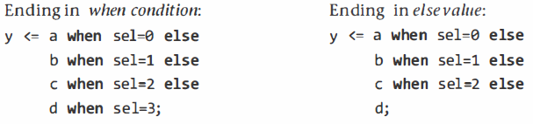
The when Statement
Example codes
The option on the left (ending with "when condition") is obviously more informative than that on the right (ending in "else value")

Slide 6
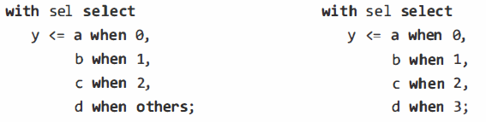
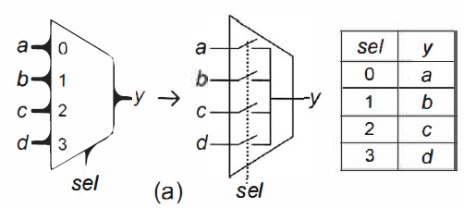
The select Statement
The target in the syntax above is a signal
The value can range from a simple static value to several values.
The example below shows an implementation for the multiplexer

Slide 7
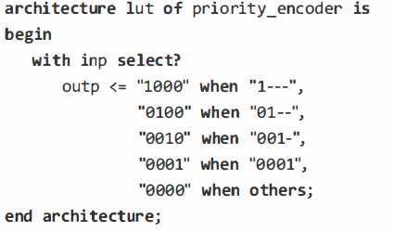
The select? Statement
The matching select statement (select?) employs the matching equality comparator (?=)
This statement is particularly useful when the truth table contains "don't care" values at the input
Observe also that the statement ends with "when others," so all truth table entries are covered, allowing select? to be synthesized.

Slide 8
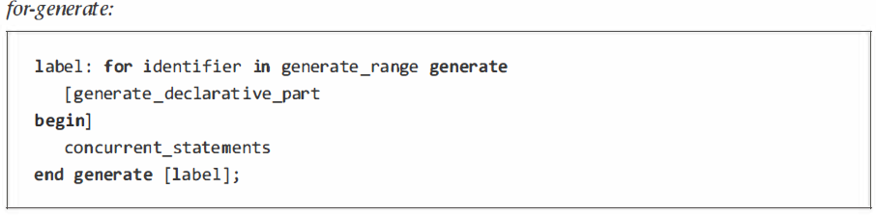
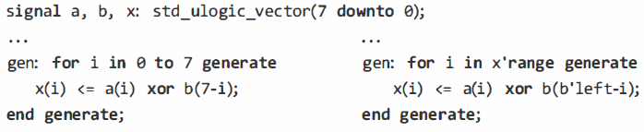
The generate Statement
There are three versions for this statement: for-generate, if-generate, and case-generate.
This is the most frequently used form of generate.
It acts as a loop, but because it is a concurrent statement, a piece of hardware is inferred every time the loop goes around.

Slide 9
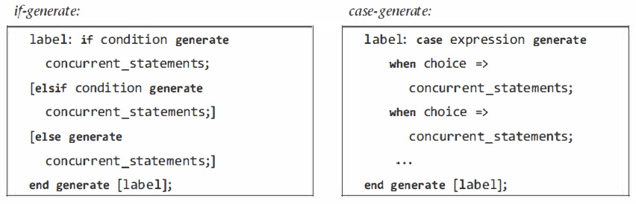
The generate Statement
There other two forms of generate are:
This is the most frequently used form of generate.
It acts as a loop, but because it is a concurrent statement, a piece of hardware is inferred every time the loop goes around.

Slide 10
Sequential Code
Sequential code is needed to build sequential circuits, but it allows the construction of combinational circuits as well
Besides process, there are two other constructs in VHDL that are internally sequential, called function and procedure - collectively referred to as subprograms
The when and select statements have both concurrent and sequential versions.

Slide 11
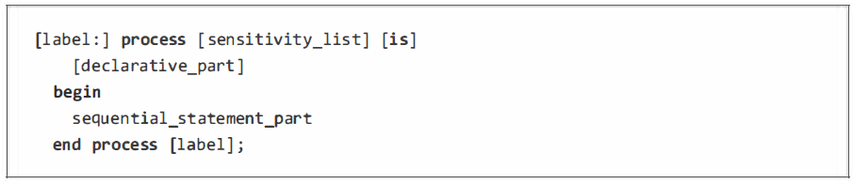
The Process Statement
A process as a whole is a concurrent statement, but internally it is a region of sequential code
Only sequential statements (if, case, loop, and wait, plus the sequential versions of when and select) are allowed inside it
The label in the syntax above is optional – for improving readability.
The sensitivity list is responsible for waking the process, causing it to execute, which occurs when any signal in the list changes
The end process keywords mart end of execution, but the actual suspension mechanism is an implicit wait statement located just before the end process keywords
If an explicit wait statement is used in the process, the sensitivity list is not allowed.

Slide 12
The Process Statement
The declarative part is optional - can contain declarations of type, subtypes …
It can also contain full subprograms, full packages, and use clauses.
Signal declarations are not allowed, while variable declarations are by far the most common.
The statement part of a process, which is where the circuit or a portion of it is actually built
It can contain only sequential statements and subprogram calls
An incorrectly filled sensitivity list should always be treated as a serious mistake

Slide 13
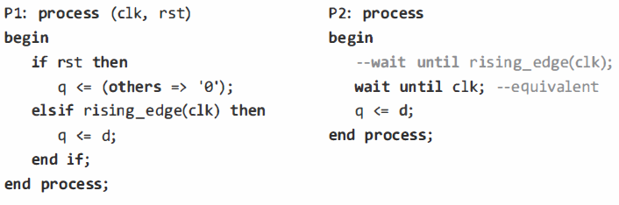
The Process Statement
Flip-flop inference Example – with and without sensitivity list

Slide 14
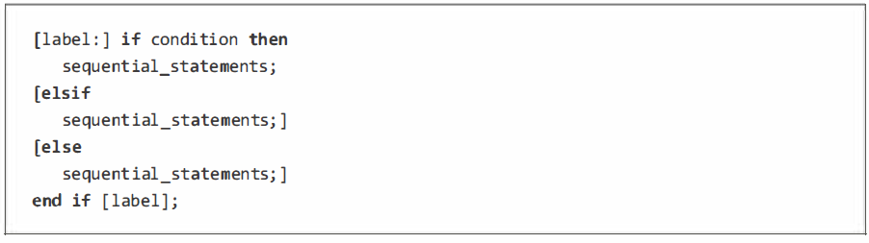
The if Statement
This is the sequential counterpart of the concurrent when statement,
Any number of elsif clauses is allowed.
It has the priority-encoding nature.
The reserved word unaffected or the null statement-both indicating that no action should take place-are allowed to be used with the if statement,

Slide 15
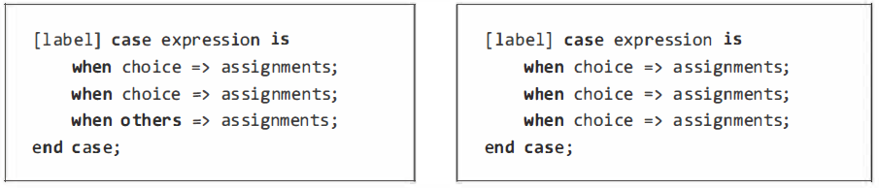
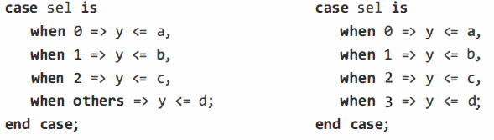
The case Statement
The case statement is the sequential counterpart of the concurrent select statement
Its main use is to enter straightforward truth tables, which case does better than if,
Does not posses the priority-encoding nature
Multiplexer example

Slide 16
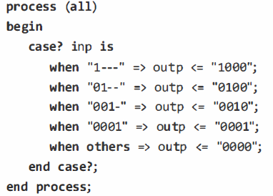
The case? Statement
The matching case statement (case?) employs the matching equality comparator (?=).
It assumes the following for std_ulogic values: ‘0' =‘L’, '1’ = ‘H’, and '-' = any value.
Any other combination returns 'U' or 'X' or 'e‘.
This statement is particularly useful when the truth table contains "don't care" values at the input
Priority encoder example

Slide 17
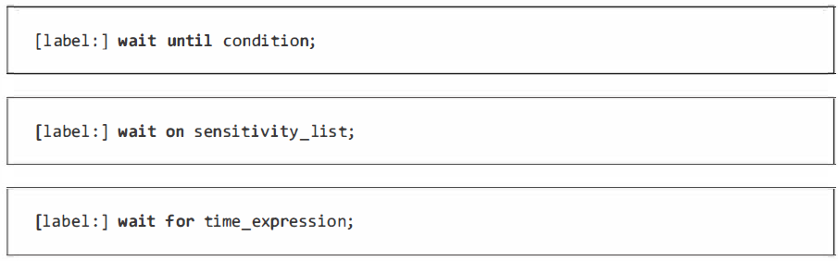
The wait Statement
Recall that when an explicit wait is included in a process, the sensitivity list must be omitted.
It is available in four forms:
wait (unconditional),
wait until,
wait on, and
wait for (the first and last are for simulation).

Slide 18
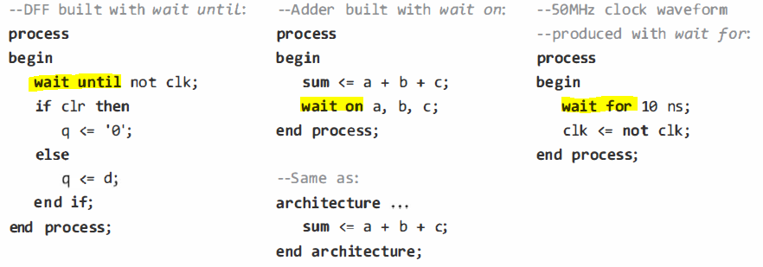
The wait Statement
Examples

Slide 19
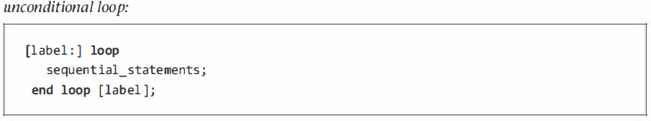
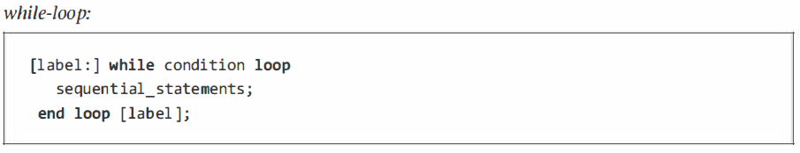
The loop Statement
Used when a section of code must be repeated several times.
There are five versions for the loop statement: unconditional loop, while-loop, for-loop, loop with exit, and loop with next.

Slide 20
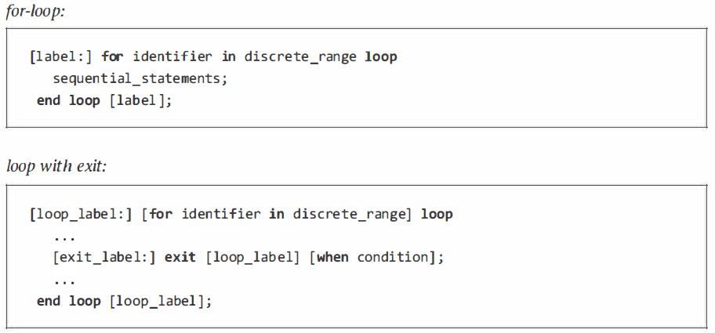
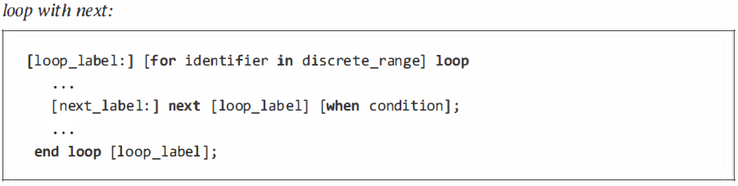
The loop Statement

Slide 21
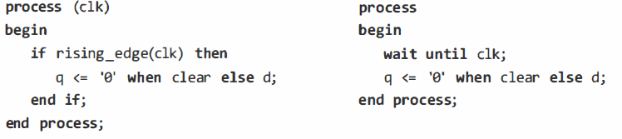
The Sequential when and select Statements
VHDL-2008 added sequential versions of when and select statements, which originally had only the concurrent versions
Their syntaxes and properties are the same as in concurrent.
Example: most compact implementation of DFFs.

